Slide 1
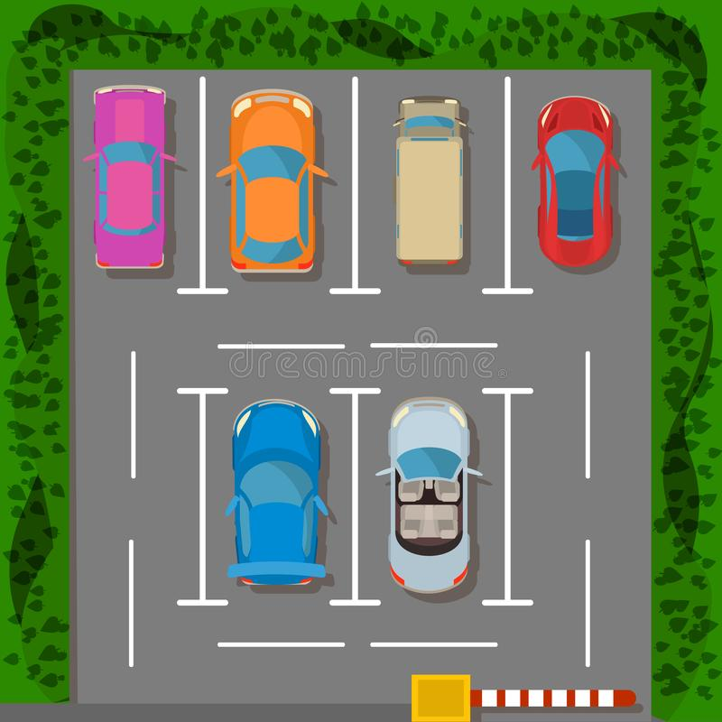
Parkade System
2031008 – Aswath A R
2031033 – Praveen kumar M

Slide 2
In a Normal Parking lot
1
2
3
Display Slots available on Parking lot
Park their vehicles in the parking lot.
Remove Vehicles from parking lot

Slide 3
What Actually a Parking Lot Need
4
5
6
Information about the car to keep track of it with Number Plate
Show the current Vehicles on the parking lot
Bills the Customer

Slide 4
Project’s Description

Slide 5
This is what we do
Customers can park their Vehicle if there is any spots available.
Customers will be asked to pay when they leave the parking lot.
Parking lot can see what Vehicle are currently parked and how many spaces are available there.
According to the type of Vehicle the space is allocated.

Slide 6


